Slide 1
The Power of Data Integration: Salesforce and Snowflake

Slide 2
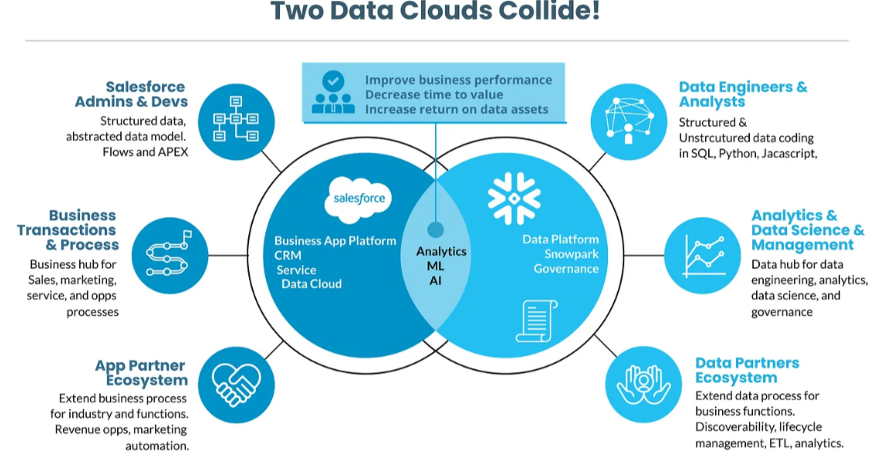
Introduction to Salesforce and Snowflake Integration Why Integrate Salesforce with Snowflake? Salesforce: Leading CRM and customer data platform. Snowflake: Advanced data platform for analytics, storage, and data sharing. Goal: Combine strengths to improve business performance, reduce time-to-value, and maximize data asset returns.

Slide 3
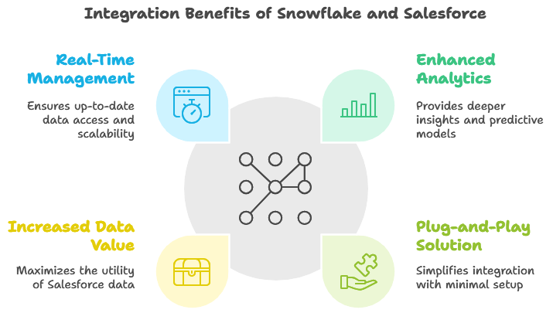
Rationale for Integration, Why Integrate Snowflake with Salesforce? Enhanced Analytics and Insights: Traditionally, companies extracted Salesforce data into data warehouses or BI platforms for analytics, reports, and predictive models. With the growth of Salesforce, more data-intensive insights are now needed. Plug-and-Play Solution: Snowflake provides an easy-to-setup integration that doesn’t require complex database management or development. Increased Value from Data: Extracts greater value from Salesforce data, enabling unified, in-depth analytics and data-driven decisions. Real-Time and Scalable Data Management: Offers real-time data access and scalability to handle structured and unstructured data.

Slide 4
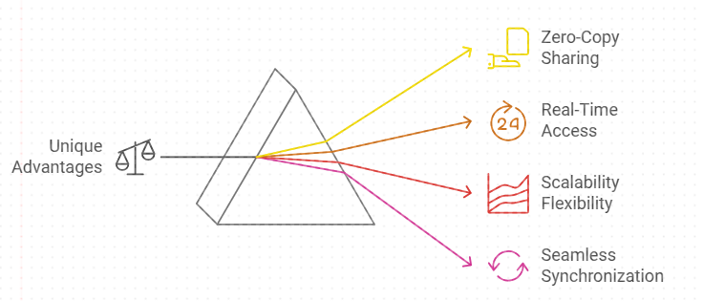
Key Benefits of Snowflake Data Cloud for Salesforce Users
Snowflake’s Unique Advantages for Salesforce
Zero-Copy Data Sharing: Access and analyze data without duplication.
Real-Time Data Access: Near real-time insights without ETL processes.
Scalability and Flexibility: Manage structured and unstructured data effortlessly.
Seamless Data Synchronization: Salesforce’s “Bring Your Own Lake” (BYOL) Data Sharing with Snowflake allows real-time integration without duplicating data, enabling faster insights.

Slide 5
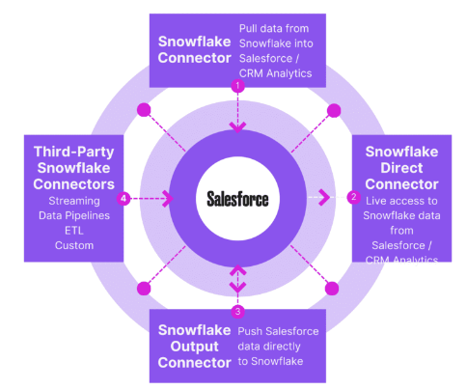
Salesforce and Snowflake Data Synchronization Options Connecting Salesforce and Snowflake Content: Overview of connector types: Snowflake Connector: Pulls Snowflake data into Salesforce for analytics. Direct Connector: Provides live access to Snowflake data in Salesforce. Output Connector: Exports Salesforce data to Snowflake for more complex analysis. Third-Party Connectors: Additional options for ETL, data pipelines, and streaming.

Slide 6
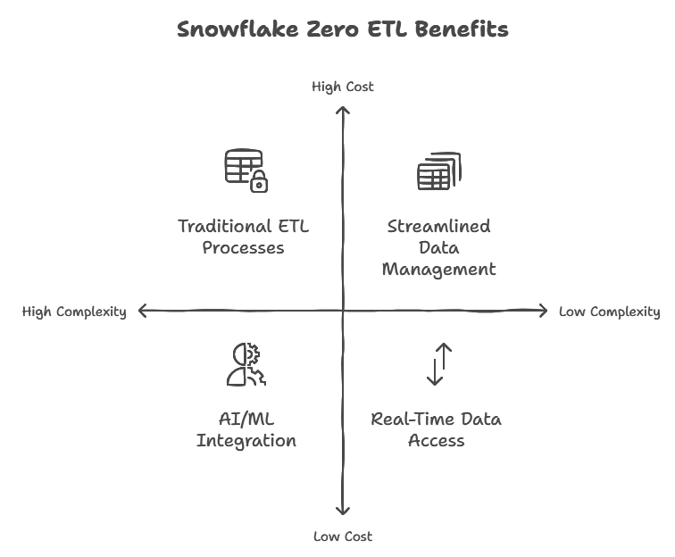
Real-Time Insights with Zero ETL
Zero ETL for Real-Time Data and AI Insights
Direct Access to Current Data: Eliminates the need for traditional ETL processes, with Snowflake acting as a supercharged data platform for Salesforce.
Streamlined Data Management: Reduces costs and complexity, aligning with Snowflake’s goal of creating a “Zero-ETL” environment.
Outcome: Faster, more accurate decision-making with AI/ML integration.
Example: Retailers using Snowflake and Salesforce for dynamic inventory management and targeted marketing.

Slide 7
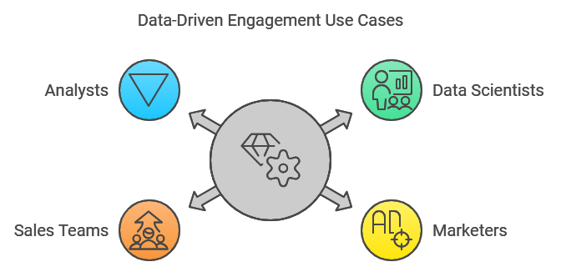
Data-Driven Engagement Use Cases
Unlocking Customer Insights Across Roles
Examples of role-specific benefits:
Data Scientists: Build propensity models using Snowflake’s analytics capabilities.
Marketers: Enhance segmentation and personalize campaigns by combining CRM and non-CRM data.
Sales Teams: Utilize intelligent forecasting and performance analytics by integrating Salesforce CRM data with third-party data in Snowflake.
Analysts: Merge historical sales and contact data with external data sources in Snowflake for strategic insights.

Slide 8
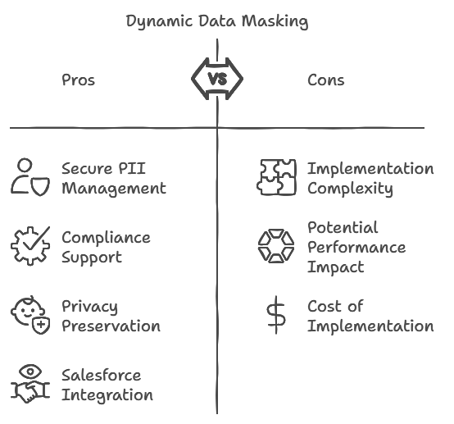
Enhanced Security and Compliance with Dynamic Data Masking
Protect Customer Data with Dynamic Data Masking
Secure PII Management: Role-based access controls to safeguard sensitive data.
Compliance: Supports GDPR, CCPA, and other privacy regulations.
Data Masking for Privacy: Allows data usage for analytics while ensuring privacy.
Benefit for Salesforce Customers: Ensures that data in both platforms meets stringent security and privacy standards.

Slide 9
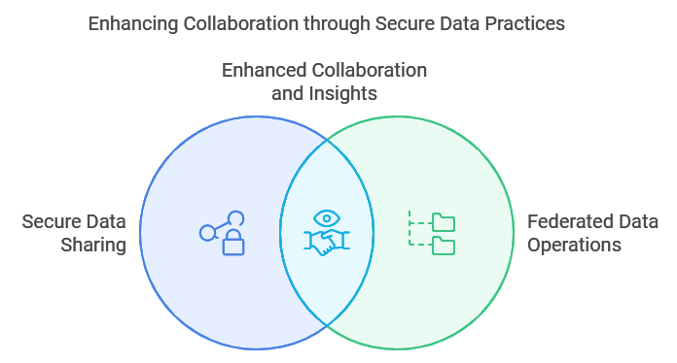
Private Data Exchange for Cross-Functional Collaboration
Streamlining Data Collaboration with Private Data Exchange
Secure Data Sharing Across Departments: Enhances insights and collaboration across business units.
Federated Data Operations: Facilitates data access within organizations and allows data teams to securely share insights.
Data Monetization Opportunities: Enables data monetization with trusted partners by creating a secure, private data exchange environment.

Slide 10
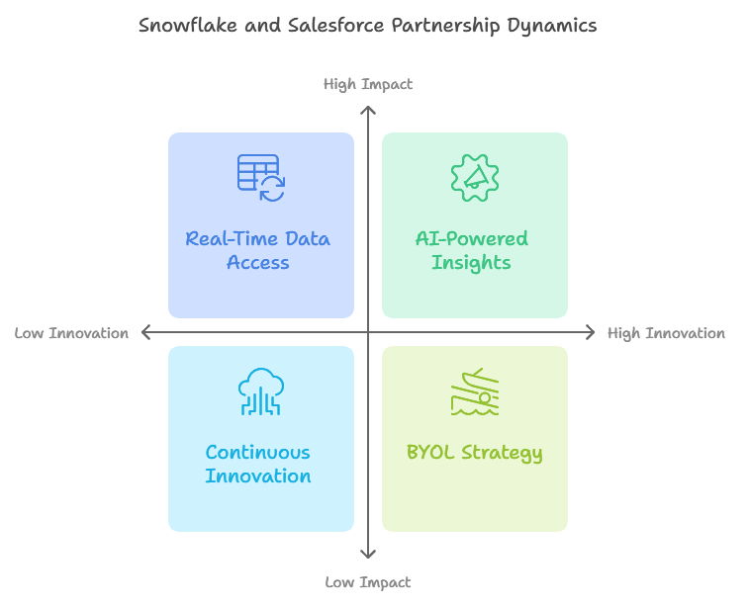
Snowflake and Salesforce’s Data Cloud Partnership Shaping the Future of Data and AI-Driven Success Bi-Directional Data Sharing and BYOL (Bring Your Own Lake): Plans for seamless, real-time data access across the Salesforce Customer 360 and Snowflake’s Data Cloud. Impact: Improved customer experiences through AI-powered insights and real-time data synchronization. Continuous Innovation: Snowflake and Salesforce's shared vision for a unified, data-driven future where customers can access timely, relevant insights effortlessly. Visual: Use a futuristic or innovation-themed icon.

